Slide 1
SMART PUBLIC RESTROOM
PREPARED BY
NAME
NAME
NAME
NAME
NAME
1.Mohanraj.P
2.Kabilesh.T.R.V
3.Janakiraman.S
4.Deepath.A
5.Ranjith Kumar.R
PROJECT

Slide 2
SMART PUBLIC RESTROOM
Abstract
The COVID-19 pandemic has subjected everyone to an unprecedented shift in the way of their everyday life in which fundamental social and work etiquette evolved with taking extra safety measures to contain the virus. A new normal has been introduced to prevent the virus's further spread, such as wearing a mask, observing proper hand hygiene, and most importantly, physical distancing by staying 6 feet away from others. Public bathrooms are inevitable to long lines that would be deemed unsafe in the pandemic since a person’s exposure time is a significant factor with the transmission. The system design in this study would help improve user experience in public restrooms by eliminating long waiting lines caused by poor communication on a cubicle's vacancy status. With utilizing the technology of IoT (Internet of Things), the public would be able to use restrooms with ease without worrying about long queues. It would also help reduce interaction with other people, which is functional in the ongoing pandemic and could also promote a safe way of using public restrooms by encouraging the public to observe social distancing.

Slide 3
Introduction:
1 Background of the Study The system “IoT Based Cubicle Occupancy Indicator” will provide an easy way to identify the occupancy of the cubicle, so people won’t have to constantly look whether the cubicle is occupied or not. With the use of a Passive Infra-Red (PIR) sensor that will detect if someone is using the cubicle and minimize excessive people in restrooms. The Passive Infra-Red (PIR) sensor responds to changes in the temperature pattern across the sensor's field of view. The sensor is passive because it does not emit any energy itself but sends a signal based on the pattern of infrared radiation in the environment (Guo and Tiller, 2010). The sensor recognizes infrared light emitted from nearby objects wherein the system can detect whether the specific cubicle is currently occupied or not. The system will show the information of the occupancy of the cubicle to an IoT Server wherein the people can identify the cubicle usage. An IoT server is also known as the Data Integration center which consists of highly reliable industrial computer and non-programming data integration software. It equips standard data management functions developed especially for data collection, process, saving, notice and publishing. The PIR sensor would relay the information of the cubicle occupancy through the LED lights placed in the bathroom entrance. This aims to fully combat the existence of the different variant transmission in public restrooms due to being a crowded place. With the introduction of these instruments in every cubicle it will further give necessary precaution to people who are being stuck in long queues, in that way possible they’ll look for an alternative way that they can do to avoid being exposed from other people and preventing in catching the virus, and at the same time it will lessen their chances in getting infected.
1.2 Problems or Opportunities IoT Based Cubicle Occupancy Indicator will serve as an opportunity for other people to conserve or lessen the time to search for an empty toilet. Many of us know that when the call of nature, sometimes there are problems or complications like the restroom is closed due to maintenance or the worse is if the restroom has tons of lines outside, wherein you must decide whether you will fall in line or search for another restroom. As observed in the effect of the COVID-19 restrictions, not all establishment’s restrooms are open. In effect, it creates long queue in those open restrooms. But in this IoT Based Cubicle Occupancy Indicator, the line could be lessened because people could know which rest room has no occupants on one of its cubicles.

Slide 4
1.3 Project Objective:IoT Based Cubicle Occupancy Indicator is a project that aims to create a new system for monitoring public restroom cubicle occupancies to present an automated IoT solution relevant to the pandemic situation. Through the system, users can view available cubicles without entering and checking each door, thereby providing a better user experience. A display is provided programmed through an Arduino microcontroller where people can be informed whether they must wait outside or proceed inside the public restroom to occupy cubicle vacancies. It aims to provide a means to exercise physical distancing policies implemented to ensure less formation of crowding, which can also be of value even after the pandemic ends. This will reduce the number of people in the restroom to provide them with more personal space while also increasing their safety from COVID-19 transmissions by having less contact with people.
2.Literature Review & Studies
2.1 Visibility of System Status:The ten principles of user interface design by Nielsen (2020) places visibility of system status as usability heuristic number one. Communication between a system and its use is essential for a designer to create a userfriendly system design. Nielsen stated it is important for users to be informed about what is going on in a system or any design (Nielsen 2020, Harley (2018) defined the visibility of a system status as the system's capability to convey its position to the users.
Good heuristic design practice should always keep users informed and updated on the status of a system (Harley 2018). A study of Pernice described and enumerated different user experiences in public bathrooms and stated three reasons behind long waiting lines in public restrooms and poor communication of the stalls' status. Most public bathrooms don’t have conductors or attendants to maintain and guide people in vacant cubicles suggestion to improve user design for public bathrooms stated that a visual indicator can save time for users. Common public restrooms have already had these visual indicators such as locks that changes color when locked, a digital door that changes color, flags on top of cubicles, and weighted stall doors that usually open by default (Pernice 2019).

Slide 5
2.2 Internet of Things:A study by Chide et. al; describes IoT or Internet of Things as a collection of computing devices that carries the capability to transfer data or information over the network without manual interventions. Internet of things is a large network that governs the idea of connecting all computing devices to the network in the world. It transmits and receives real-time information collected by media devices/sensors. IoT can not only track and record information but can also monitor and respond to changes in the environment (Chide et al. 2020). In a study by Nasajpour et al. (2020) it emphasized that IoT plays a major role in the revolution of healthcare solutions by incorporating technological aspects to medical needs IoT is composed of four primary technologies that enables
real-time data gathering and processing, RFID technology for tagging, sensor technology for gathering information, existing smart technologies for the data processing and nanotechnology for portability (Nasajpour et al. 2020). In an IoT Project entitled, Distansya: An IoT Platform to Physical Distancing Provision Notification, the main goal is to construct a prototype system that combines inexpensive yet effective IoT technology with standard deterrent equipment like a face shield. This would be accomplished by first exploring pertinent related literature and prior projects referring to specific components such as ultrasonic sensors, photoresistors, and lidar sensors, which do not need to be employed at the same time as before (Blancaflor et al. 2021).

Slide 6
2.3 Passive InfraRed Motion Sensor
PIR or Passive InfraRed motion sensor is a type of sensor that detects motion from the infrared light emitted from nearby objects. These sensors are commonly used in security alarms and automatic lighting applications because of its portable build and how it consumes minimal power. PIRs are composed of pyroelectric sensor that can detect different levels of infrared radiation an object or a human emits. PIR sensors are split into two in which the sensors can detect motion change and not the average IR levels. These two sensors are made up of material that is sensitive to IR to easily detect the changes in motion. When the sensors are in an idle state, they receive the same amount of IR which can be the ambient amount radiated from walls or from outside. Everything emits low level of radiation which and the hotter an object is the more radiation is emitted. The sensors are triggered when a source of heat, which could be a human or an animal, passes by, it would first trigger one half of the IR sensor that would eventually cause a positive differential change between the two sensors and when the source of heat is outside of the sensing area, the sensor generates negative differential change. The IR source fluctuations that occur is the measure that the sensors detect to create an output (Ada 2014).
2.4 Occupancy Indicator
Occupancy sensor technologies give the information that enables space use measurement and management. These technologies have the advantage that can be developed slowly after processing the outputs. According to Tom Bell, Accuracy is critical for occupancy data. Occupancy metrics rely on data from people counting sensors that measure the number of people entering and leaving a building. If the count of people going in or out is not accurate, then over time this can lead to a build-up or accumulation of errors (Bell 2020). The accuracy of occupancy indicator identifies the reliability of occupancy information. The resolution of occupancy indicator is defined in temporal, spatial, and occupant dimensions. As the resolution of a sensor increases, the information is available faster, the observed space can be studied in more detail, and the occupants become more defined (Melfi 2011). A study by Aizizi et al. (2019) indicate that occupancy indicator technologies can significantly improve the energy efficiency in non-residential buildings by occupancy-based control strategies that can reach over 50% energy saving (Aizizi et al. 2019).

Slide 7
2.5 IoT Powered Restroom Usage Indication System
A study by Chang (2020) aims to increase productivity and working convenience using a cost-efficient IoT motion detection system. The study addresses the problem which revolves around the usage of the restroom where more than 20 people work. This is because only a single toilet is available on that certain floor, causing instances wherein people leave their working station only to find out that the restroom has been occupied. Thereby proposing a solution for people to be informed using an Arduino circuit-based system and an infrared sensor to detect toilet occupancy. Data is sent using a WIFI module to the IoT server for a quick relay of information among the workers. The design of the system involves an Arduino Uno circuit board, passive infrared sensor, WIFI module, and a low-cost WIFI microchip, specifically ESP8266. The PIR sensor was first connected to the board to test its motion sensing functionality by displaying a message on the serial monitor. Afterwards, the WIFI module was connected and programmed with the PIR sensor in Arduino’s Integrated Development Environment. There was an error of “time out waiting for packet header” encountered when configuring the ESP8266 to connect to their office WIFI network which was resolved with the use of ‘AT’ commands in the serial monitor to allow the user to control the Arduino. The system also made use of API keys from ThingSpeak platform to access and import data to the website to inform the employees every 15 seconds. The breadboard was replaced with a prototype shield to maintain connections and modified the PIR sensor’s delay time and sensitivity to increase accuracy in detection due to it being affected by factors such as wind, sudden change in temperature, prolonged delay time, and others. The sensor was encased, and a Fresnel lens was attached to it for a better performance by broadening its sensing capability. During testing, this study found out that it was not possible to eliminate all false positives. Being a low-cost designed system, the battery was not sufficient to keep the PIR sensor from functioning on a longer pace. Moreover, the PIR sensor used was also not advanced which resulted to a lot of false positives. It was also recommended that an Arduino Nano should be used instead of Arduino UNO for reducing power consumption (Chang, 2020).

Slide 8
2.6 IoT Based Smart Cubicle System for Effective Power Usage and Employee Monitoring in Offices
The objective of this research is to develop smart cubicle system that focuses on light system intelligent using passive infrared sensor (PIR) or light dependent resistors (LDR). The first sensor that can be used is passive infrared sensor, there has more sensor that can be used, but PIR can be considered the most taken in field of sensor. The PIR sensor can detect human body heat. The LDR can measure the light intensity and it have a sensitivity that measure the wavelength of the light. In an office setup, every cubicle has light source in this project the researcher suggests that each cubicle will use individual circuitry in every light bulb installed. That conclude PIR sensors will be used for sensing the occupancy of the cubicle, LDR to compute the intensity of the light. In every cubicle the light will switched on when only the sensor detects a human body. Both PIR and LDR can work 24 hours, whenever PIR sensor detect human body, LDR also can detect that reading. By this we can know if the cubicle is occupied or not (Coehlo et al. 2018).
2.7 Smart toilet: threats and challenges identifying human presence using iot sensors
The study’s objective is to present a design and implementation between an ultrasonic sensor and an infrared sensor in detecting the presence of a human and the distance involved in the smart toilet. The paper used an ultrasonic sensor module (HC-SR04) and sharp GP2Y0A02YK0F analogue distance sensor to detect distance at a specific value. The paper proposes a design of a detection system that would be able to properly detect human position in different defecation posture. The system’s goal in this paper is to provide a more reliable system that is sensitive to environmental noise. Different body sizes are considered a challenge for detecting human presence since it gives an unstable reading for the ultrasonic sensor that is why 10kΩ is added to the trigger pin for the ultrasonic sensor to provide a more accurate reading. The testing done for the sensors involves placing the ultrasonic and infrared sensor in a different position above the cubicle. The Raspberry Pi is programmed in Python language and is responsible for getting the measure of the distance and detect the presence of the human body.

Slide 9
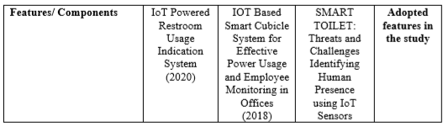
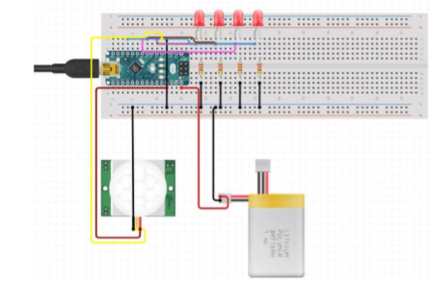
2.8 Benchmark Study
3. Methodology
3.1 System Design
Figure 1. Project Schematic Diagram
Figure 1 presents the connection layout for the Arduino Nano board. This includes a PIR motion sensor, Red LED lights, and a 7.4V battery

Slide 10
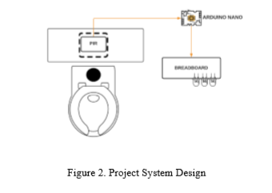
Figure 2 provides visual presentation of the process flow described in the project. The board would be placed in a flat surface above the toilet and facing the door for a more accurate detection range for the sensor. The board, which is composed of a PIR motion sensor and WIFI module would then relay occupancy information in the cubicle in the indicator

Slide 11
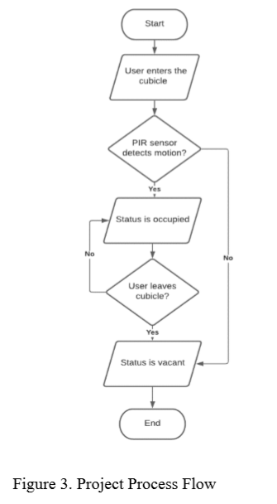
3.2 Process Flow

Slide 12
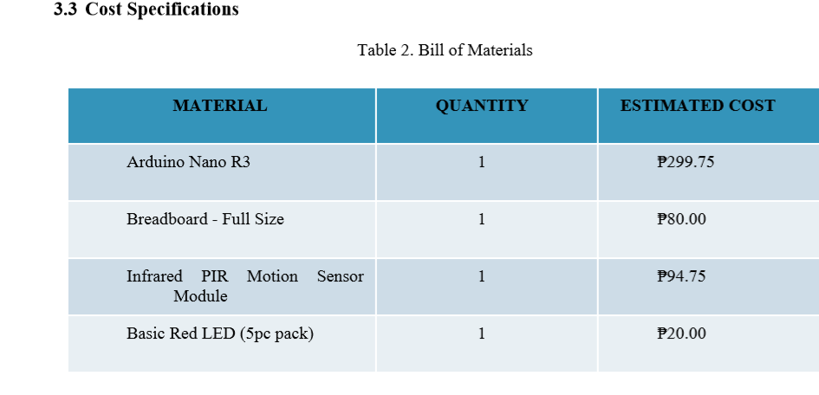
Figure 3 describes the process flow for the project. The process will start when a person enters the cubicle in a restroom with an operating PIR sensor which will be placed on top of the toilet. The heat coming from that human presence would be detected by the PIR sensor and the information would then be processed through the Arduino controller to reflect the occupancy details using simple LED lights. The prototype design was simulated in a simulation platform, Tinkercad. Simulation results presented a 100 percent success rate on the main functionalities set in this study.

Slide 13
4. Conclusion
The system design in this study would help improve user experience in public restrooms by eliminating long waiting lines caused by poor communication on a cubicle's vacancy status. With utilizing the technology of IoT (Internet of Things), the public would be able to use restrooms with ease without worrying about long queues. It would also help reduce interaction with other people, which in times of the ongoing pandemic, is useful and could also promote a safe way of using public restrooms by encouraging the public to observe social distancing. Proper information relay about a cubicle’s occupancy would also save time as well as increase productivity when it comes to office environments.
Some restrictions were made upon the implementation and testing of the system which limited the capacity of the system to visualize information. The current system in the study can only accommodate public restrooms with no more than five cubicles due to the nature of the lack of a portable way of visualizing the processed data. The study made use of LED lights for indicators in each cubicle; if the system were to be implemented in a bigger environment, it is highly recommended to use other existing IoT platform that enables the wireless display of information. The use of a WIFI module is preferable to provide a seamless wireless display of information.

Slide 14
INNOVATION OF SMART PUBLIC RESTROOM
DUAC Smart Public Toilet
In India it is estimated that on an average about 60% of the population have no toilets in their homes. The number is still higher in rural areas at about 72%. The condition of the limited number of existing public toilets being pathetic people prefer to defecate in the open thereby compromising themselves to dreadful diseases like cholera, typhoid, hepatitis, jaundice etc. It is estimated that there are above 25 lakh women in Delhi who go for their necessary functions before dawn every morning in the open fields putting their lives to risk in view of the high level of crimes against women. The Commission has always believed that adequate civic amenities help in enhancing the aesthetics of a city. In view of the unsatisfactory situation relating to public toilets in the city of Delhi, the Commission felt that it is high time that an initiative was taken for developing high tech self sustaining public toilets which could be put up in slums, unauthorised colonies, market places and in other places like gardens and parks where foot fall is high. After receiving approval from the Government in the year 2012 on a proposal mooted by it ,the Commission on the basis of a design competition developed a prototype for a low cost self sustaining High-Tech Public Toilets which has been installed at various locations around New Delhi

Slide 15
Objectives
• Distinctive & aesthetically pleasing designs.
• Smart, contemporary and environment friendly features. Industrially prefabricated designs for mass production.
• Long life tenure of approximately 15-20 years.
• Tentative cost INR 1.50 lakh per seat.
• Hassle free transportation to predesignated sites for quick installation.
• Adequate space for advertisement and revenue Generation.

Slide 16

DESIGN 1 (Size of one unit - 1.40m X 1.40m) (Internal height - 2.20m)
Inspired by the vernacular architecture using “Bamboo” as the primary theme.
Specification :
• Exteriors: Fibre reinforced plastic (FRP)
•Interiors: Stainless steel 304 grade , 1mm thick
•Frame: Mild steel (MS)

Slide 17
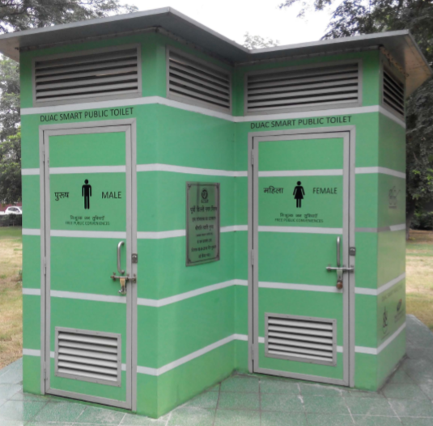
DESIGN 2 (Size of one unit - 1.50m X 2.60m) (Internal height - 2.20m)
A hexagonal twin unit design having male and female compartments alongside.
Specification :
•Exteriors: Polypropylene honey comb, Polyurethane (PU) painted.
•Interiors: Stainless steel 304 grade, 1mm thick
•Frame: Polypropylene honey comb folding wall

Slide 18
DEVELOPEMENT 2 FOR SMART PUBLIC TOILET
WORKING MODEL:
The gas sensor is placed below the rim of the Toilet basin, to detect undesirable gases present in the confined toilet space. If the sensor detects the foul smell, it activates the motor and closes the lid. Once the lid is closed, touch sensor get pressed, which initiates the motor for automatic flushing. The gravity aurdino turbidity sensor detects quality of water by determining the intensities of turbidity. This sensor is deployed in the flush water tank to determine the quality of water and to check bacterial presence. If the turbidity level rises, it generates a signal and alerts the toilet maintenance team and displays Service Required message in the LCD Monitor connected to the door
As the user enters the washroom, he/she reads the LCD display connected to the door, if it displays Ready to Use message , user enters the toilet and put the hand over IR sensor to activate the motor, once the motor gets activated, it closes the toilet lid and automatic flushing is done. Once the toilet basin is clean, IR sensor is used to open the lid and the toilet seat cover. If foul smell is detected continuously it alerts the toilet maintenance team. The maintenance monitoring team worker will be provided with Radio Frequency Identification (RFID) tag, with identification code.

Slide 19
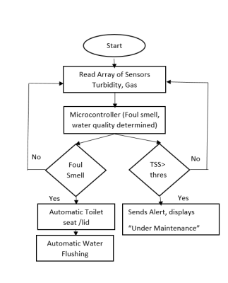
1.FLOW CHART

Slide 20
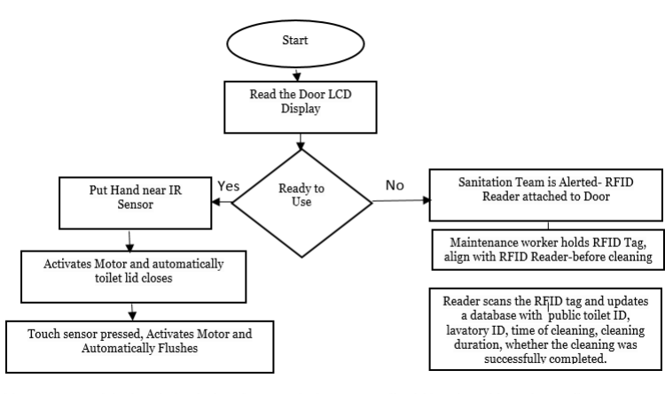
2.FLOW CHART

Slide 21
Anaerobic sewage tank is deeply buried and covered, the sewage liquid level could not be easily monitored. Traditional techniques like floating ball liquid sewage level determination requires to soak the floating ball in sewage liquid, the major setback is the floating ball gets strained over time and leads to malfunctioning. In our proposed system Ultrasonic sensor is fixed below the lower part of the tank cover plate. MAX485 is a low slew rate and low power transceiver, ported with Ultrasonic sensor for signal reception and transmission to microcontroller. The microcontroller output is connected to liquid crystal display, which displays real time liquid sewage level, if the level exceed the threshold alert signal is sent through buzzer.

Slide 22
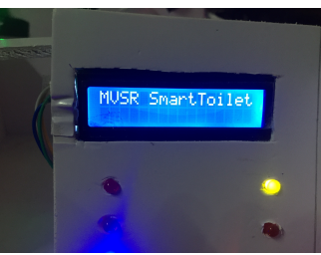
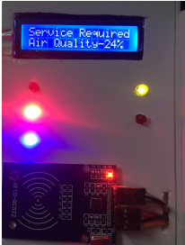
RESULTS AND DISCUSSION
1.LCD Monitor Displaying Status of Smart Toilet
2.LCD Monitor Displaying Status of Smart Toilet

Slide 23
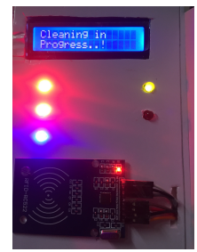
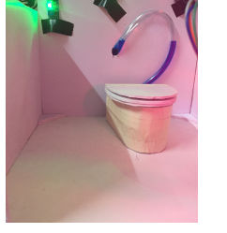
3. LCD Monitor Displaying Status of Smart Toilet
4.Automatic Lid Closure

Slide 24
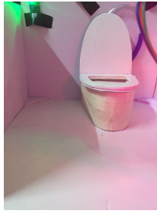
4.Automatic Lid Opening

